Slide 1



TOLL MATE
GPS BASED TOLL SYSTEM

Slide 2
PROBLEM STATEMENT
Components of the Simulation:
1. Vehicle Movement Simulation: Simulate vehicles moving along predefined routes with GPS coordinates.
2. Toll Zone Definition: Define toll zones or points with GPS coordinates.
3. Distance Calculation: Calculate the distance traveled by each vehicle within toll zones.
4. Toll Calculation: Compute toll charges based on distance traveled or zones passed.
5. Payment Simulation: Simulate the process of deducting toll charges from user accounts.
Python Libraries and Frameworks:
▪ Simulation Frameworks: Use SimPy for event-driven simulation to model the vehicle movements and interactions within the system.
▪ Geospatial Analysis: Utilize GeoPandas and shapely for defining toll zones and calculating intersections between vehicle paths and these zones.
▪ Distance Calculation: Employ GeoPy for distance calculations between GPS coordinates.
▪ Data Handling: Use pandas for managing and analyzing data related to vehicles, toll transactions, and user accounts.
▪ Visualization: Leverage Matplotlib and Folium for visualizing the simulation, including vehicle movements and toll zone locations on maps.

Slide 3
PROBLEM STATEMENT
Example Simulation Workflow:
1. Setup Environment:
▪ Define road network and toll zones using geospatial coordinates.
▪ Initialize vehicles with starting locations and destinations.
2. Simulate Vehicle Movement:
▪ Use SimPy to simulate vehicle movement along the network, updating GPS coordinates over time.
3. Detect Toll Zone Crossings:
▪ Check if a vehicle's path intersects with a toll zone using shapely and GeoPandas.
4. Calculate Toll Charges:
▪ Calculate tolls based on the type of crossing (distance within zone or fixed fee for zone crossing) using predefined rates.
5. Simulate Payments:
▪ Deduct toll charges from the simulated user account balances.
6. Analytics and Reporting:
▪ Generate reports on vehicle movements, toll collections, and system performance

Slide 4
ABOUT THE WEBSITE:
The website aims to simulate the forthcoming technology of a GPS-based Toll System in India,
set to replace the current Fastag Technology. In a real-world scenario, when a vehicle enters the toll zone,
a scanner at the entry point scans the GPS chip and information chip in the vehicle's number plate,
retrieving data about the GPS coordinates, car details, and owner account information. As soon as the
vehicle exits the toll zone, the toll amount is deducted from the user's account, and a receipt is generated
and sent to the app along with an update to the user's transaction history.
In my web app, after entering your credentials, you will see your dashboard. Upon clicking the
"Start Simulation“ button, the simulation begins, where a car is made to travel from a random entry
point to an exit point, mimicking the movement of a car in an actual toll zone. Once your car exits the
toll zone, the toll amount is deducted based on distance calculation, and the /transactions route is
updated. This website provides a comprehensive visualization of how GPS-based toll systems would
function in real life.

Slide 5
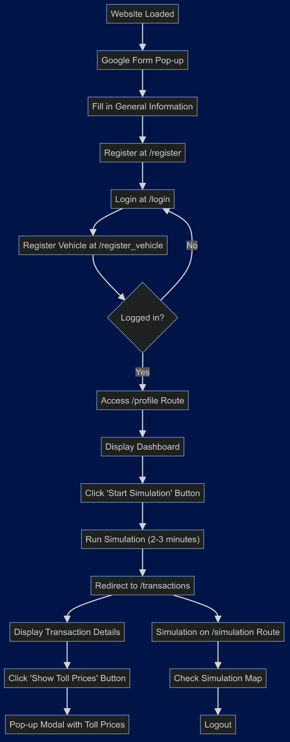
FLOWCHART
The flowchart on the right shows the working of the TOLL MATE (GPS based Toll System WebApp) . This flowchart completely demonstrates how the website functions to make it for the users to perform the tasks .

Slide 6
TECHNOLOGIES USED:
Technologies used to make the project are primarily Python and Flask for BackEnd Development and HTML,CSS,JAVASCRIPT for FRONTEND Development. For generating Google Maps and retrieving the URL of the tollzone selected for the Project , Google Cloud Console Platform and its API’s are used . Below are the Python modules used for the project:

Slide 7
TECHNOLOGIES USED:
numpy and pandas
flask
flask_bootstrap
flask_login
ast
googlemaps
simpy
geopy
folium
IPython
datetime
matplotlib
io
PIL
requests
time
random
dot_env

Slide 8
LINKS:
The link to the GITHUB repository:
https://github.com/Harshit-TheCoder/GPS-TOLL-SYSTEM-WEBAPP.git
You can refer README.md in the Repository and follow the steps to clone the repository and test the website.

Slide 9
CONCLUSION:
In conclusion, this website offers an insightful and practical simulation of the future GPS-based Toll System in India. By mimicking real-world scenarios, users can understand how vehicles will interact with toll zones, including the seamless deduction of toll charges and real-time updates to transaction histories. This simulation not only showcases the technological advancements over the current Fastag system but also demonstrates the efficiency and convenience of GPS-based toll collection. As such, it provides a comprehensive preview of how this innovative system will enhance the tolling process, ensuring a smoother and more efficient experience for users.

Slide 10
THANK YOU

